Slide 1
Introduction to git
Workshop @Uni Bonn, D. Barbi (dbarbi@uni-bonn.de)

Slide 2
Table of contents
git basics
File operations
Getting information on your repository
Synchronizing with a server
Branching
Tagging
Undoing stuff
Configuring git

Slide 3
1. git basics -- the stuff you should remember
Introduction to git

Slide 4
git basics
git command line help
git has a nice command line help:
git help
git help [config/commit/rm/...]
Gives some hints on how to use the commands, on available flags,...

Slide 5
Configuring git – mandatory
git basics
git wants to know who you are:
git config --global user.email \
dirk.barbi@awi.de
git config --global user.name \ “Dirk Barbi”
This info is needed to “sign” your commits.

Slide 6
Create a new (local) git project
git basics
cd ~/my_project
(or wherever your stuff is)
git init
(creates empty repository and .git-folder)

Slide 7
Cloning a git project
git basics
git clone --username dbarbi \ https://url-to-your-project myfolder
cd myfolder
Copies whole repository (all revisions) into folder “myfolder”, working directory = master/HEAD ).

Slide 8
Connecting a local git project to server
git basics
git remote add origin https://url-to-your-project
Identifies local repository (all revisions) with remote repository, so that changes can be exchanged.

Slide 9
Staging files / changes
git basics
“Staging” means: Mark a change so that it is added to the repository later (commit)
git add *
git add *.f90
git add src/echam/configure
git add does NOT add changes to the repository, but STAGES them!

Slide 10
Committing files / changes
git basics
git commit –m “Blabla“
Everything that has been changed AND STAGED becomes part of the new revision, which becomes HEAD-revision of trunk or branch.
git commit –a –m “Blabla“
Stage and commit all changes (svn-style).

Slide 11
Pushing files / changes to server
git basics
git push
Everything that has committed to master is sent to server (only works if merging isn‘t needed).
If remote repository is empty (master doesn‘t exist yet):
git push –all or
git push –u origin master

Slide 12
Getting files / changes from server
git basics
git pull
Gets all changes to master from server and starts to merge (if necessary)

Slide 13
Status of your repository
git basics
git status
Gives information on:
untracked files
new files
modified files
deleted files
git status –s (short)

Slide 14
Remember these:
git basics
git help
(git init/clone) (ONCE per project)
git add
git commit (-a)
git pull
git push
git status (-s)
→ At least 95% of all you need!
Notes:
Show the first two videos now (NewProject 1 and 2)

Slide 15
2. Which files get into the repository? --Adding, removing and excluding files
Introduction to git

Slide 16
Stage a new file
File operations
git add blabla.txt
Stages the file blabla.txt. Next commit will actually add it to repository.

Slide 17
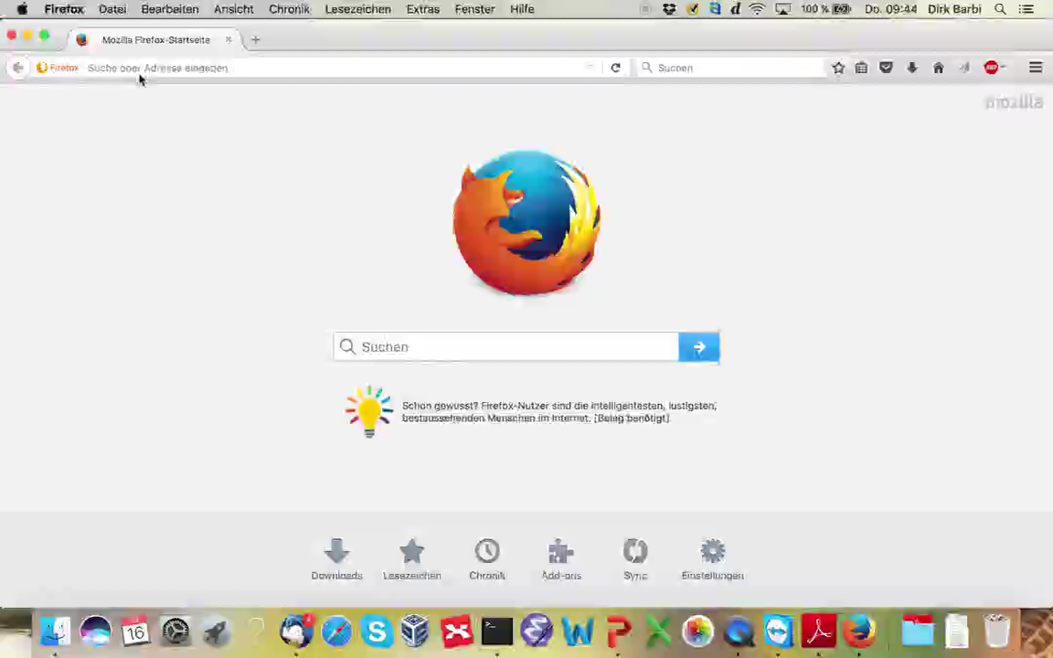
Committing files / changes
git basics
git commit –m “Blabla“
Everything that has been changed AND STAGED becomes part of the new revision, which becomes HEAD-revision of trunk or branch.
git commit –a –m “Blabla“
Stage and commit all changes (svn-style).

Slide 18
Remove a file
File operations
rm blabla.txt
git rm blabla.txt
Stages the file blabla.txt for removal. Next commit will remove it from repository AND YOUR WORKING COPY!!!
If blabla.txt already has staged changes, you need to type
git rm –f blabla.txt

Slide 19
Remove a file ONLY from repo
File operations
git rm --cached blabla.txt
Stages the file blabla.txt for removal. Next commit will remove it ONLY from repository. (For example if you don‘t want to commit your TODO.txt, compiled files, input data,...)

Slide 20
Remove several files at once
File operations
rm *.txt
git rm \*.txt
“*” needs to be escaped with a “\”, because the expansion (replacement) of “*” is done by git, not the shell.

Slide 21
Move a file around
File operations
git mv blabla.txt important.txt
Does exactly what you think it does. Could be replaced by mv, git rm, git add; but git mv keeps the history of the file intact.

Slide 22
Exclude files from repo
File operations
You can write a .gitignore-file in the same folder that contains the .git-folder and specify files NEVER to be added to the repository, e.g.:
# no .a files
*.a
# but do track lib.a
!lib.a
# ignore all .pdf files in the doc
# directory and subfolders
doc/**/*.pdf
Notes:
Show video FileManip now

Slide 23
3. What have I done??? -- More information
Introduction to git

Slide 24
What have I changed, but not staged yet?
Getting information
git diff
Gives “diff-style” information on anything that has been done, but is not staged to be committed yet.

Slide 25
What have I changed and staged?
Getting information
git diff --staged (or cached)
Gives “diff-style” information on anything that has been done, and that is staged already (so about to be committed).

Slide 26
Nicer diffs...
Getting information
git difftool (--staged)
Does the same as git diff, but displays the result in a diff viewer like opendiff, vimdiff...

Slide 27
What has been done at all?
Getting information
git log
Shows list of all commits, including author, date, and message. Try these too:
git log -2
git log –p
git log --stat
git log --pretty=oneline --graph
git log --since=2.weeks

Slide 28
4. That‘s not how I want it -- configuring git
Introduction to git

Slide 29
Some nice settings
Configuring git
git config --global core.editor \ vim
git config --global diff.tool \ vimdiff
git config –global merge.tool \ vimdiff
git config --global alias.mylog \
“log --oneline --decorate --graph”
Notes:
Show NicerLog now

Slide 30
5. Getting in sync -- synchronizing with a server
Introduction to git

Slide 31
Clone a server-based repository
Synchronizing with a server
git clone --username dbarbi https://url-of-your-project myfolder
Copies whole repository (all revisions) into working cpoy, working directory = master/HEAD.
Servers are called “remotes”.

Slide 32
Connecting a local git project to server
git basics
git remote add origin https://url-to-your-project
Identifies local repository (all revisions) with remote repository, so that changes can be exchanged.

Slide 33
Fetching changes from remote
Synchronizing with a server
git fetch
Connects to server, gathers all changes on all branches (including master) that are tracked from this remote, but doesn‘t merge with your stuff -> working directory remains unchanged.

Slide 34
Merge fetched changes
Synchronizing with a server
git merge FETCH_HEAD
Takes the changes downloaded by the last
git fetch and tries to merge them into your working directory.

Slide 35
Pulling changes from remote
Synchronizing with a server
git pull
Connects to server, gathers all changes on all branches and master, and tries to merge with your stuff -> working directory will probably change!
→ git pull = git fetch; git merge FETCH_HEAD

Slide 36
Pushing changes to remote
Synchronizing with a server
git push
Connects to server, sends all changes. Only works if you are have already the newest version of your branch!
(Otherwise you would need to pull, then push.)

Slide 37
Pushing changes to empty remote
Synchronizing with a server
If „master“ doesn‘t yet exist on the remote server, you need to use
git push –all
once. That sets up „master“ on the remote and pushes your working copy to it.

Slide 38
Show the remotes of your repo
Synchronizing with a server
git remote -v
Shows list of all remote servers that are known to git you can use to sync your project (yes, there can be more than one).
In our case, it‘s only swrepo1.awi.de, named “origin”.

Slide 39
What goes on on the remotes?
Synchronizing with a server
git remote show
Gives address of remote, and what git pull and git push would try to do (can be quite helpful).
git branch –a

Slide 40
6. More than one truth -- branching and merging
Introduction to git

Slide 41
Creating a new branch
Branching
git branch testing
Creates a new branch (“testing”), but doesn‘t switch to that branch.
A branch is actually only a POINTER to a revision! Other pointers are HEAD, master, FETCH_HEAD,...

Slide 42
Switching to another branch
Branching
git checkout testing
Switches to branch testing, so afterwards:
HEAD → testing.
In general, that will change your files!!!
git checkout –b testing2
Creates branch testing2, and change to it.

Slide 43
Which branch am I on?
Branching
git branch
Shows all branches and indicates active one.

Slide 44
Merging one branch into another
Branching
git checkout testing
git merge testing2
Changes to branch testing, then merges (or tries to merge) all changes from testing2 into testing.

Slide 45
Sharing a branch on a server
Branching
git push origin testing
Push a branch to a server. Doesn‘t happen automatically – you can keep private branches for temporary work.
git push –u origin testing
Even better – local and remote branch keep connected for further pulls.

Slide 46
What is “upstream”?
Branching
When remote and local branches are “linked”, the remote branch is called upstream.
git checkout testing → often automatic
Otherwise:
git push –u
Or:
git branch --set-upstream-to master origin/master
git branch --set-upstream-to myname origin/blabla

Slide 47
Deleting a branch
Branching
git branch –d testing2
Removes branch testing2 (that is: the pointer; the revisions stay.)
git push origin --delete testing2
Removes branch testing2 from server origin.

Slide 48
List all (local) branches
Branching
git branch –v
List of all local branches
git branch –vv
List of all tracking branches
git branch –a
List of all branches,
including remote ones

Slide 49
7. Give mayor versions a name -- tagging revisions
Introduction to git

Slide 50
Create an (annotated) tag
Tagging
git tag -a v1.0 –m “version 1.0”
Creates the tag “v1.0” together with message, author and date and adds it to the active revision.

Slide 51
Tag an older version
Tagging
git log --pretty=oneline
git tag -a v0.9 abcdef –m “blabla”
Creates the tag “v0.9” and adds it to the revision with a revision number starting with abcdef.

Slide 52
Sharing tags
Tagging
git push v1.0
Push tag “v1.0” to server.
git push --tags
Push all tags to server.

Slide 53
„Check out“ tag
Tagging
git checkout -b version1 v1.0
Make a new branch (“version1”) and initialize it to the revision that is tagged as v1.0.

Slide 54
List tags
git tag
Shows a list of all defined tags known to your database.
git tag –l “v1.*”
List all tags starting with v1.

Slide 55
Show tag info
Tagging
git show v1.0
Shows available information on tag v1.0, such as: author, date, tag description, revision number, last committing author, ...

Slide 56
8. Uuups... -- undoing stuff
Introduction to git

Slide 57
... I accidently removed / changed a file ...
Undoing stuff
git checkout -- myfile
Gets file “myfile” from the repository the way it was at the last commit.
Also:
git checkout c684v6 myfile
git checkout “c684v6~1” myfile
git checkout v1.0 myfile
git checkout mybranch -- myfile

Slide 58
... I shoudn‘t have staged THAT...
Undoing stuff
git reset HEAD myfile2
Unstages file “myfile2”, but leaves it unchanged in your working directory.

Slide 59
... much less committed...
Undoing stuff
Just keep on working, prepare your working directory as you want to commit it, then:
git commit --amend
Replaces the last commit (mostly needed when you messed up the commit message).

Slide 60
Last words
Introduction to git

Slide 61
Where to find information
Pro Git book (free pdf version online)
Cheat sheets
Lots of online resources
Get this document:
git clone https://USERNAME@gitlab.dkrz.de/esm-tools/git-workshop.git

Slide 62
git vs svn
git | svn
git clone | svn checkout
git pull | svn update
git push | svn commit
git diff | svn log
git add -A | svn import
git checkout -- file | svn revert file
git reset --hard HEAD | svn revert . -R

Slide 63
...again, remember these:
git help
(git init/clone) (ONCE per project)
git add
git commit (-a)
git pull
git push
git status (-s)
→ At least 95% of all you need!

